Slide 1
Model Tuning

Slide 2
Iterative ML development
Choose architecture
(model, data, hyperparameters,…)
Train model
Diagnostics
(bias, variance and error analysis)

Slide 3
Basic Recipe
Does the model perform well on the training set?
(High bias)
Does the model perform well on the validation/test set?
(High variance)
Done
Make a better model,
Improve input features
…
Get more data
Regularization
…

Slide 4

Orthogonalization
Bigger network,
Better features
Better architecture
Fit training set well on cost function
Fit validation set well on cost function
Fit test set well on cost function
Regularization
Bigger training set
Bigger dev set

Slide 5
Improving the model
Get more training examples fixes high variance
Add/Improve features fixes high bias, variance
Increase L2 regularization strength fixes high variance
Decrease L2 regularization strength fixes high bias
Improve the neural network fixes high bias, variance
Add batch normalization fixes high bias, variance
Add early stopping fixes high bias, variance
Add skip connection fixes high bias, variance
Change the neural network architecture fixes high bias, variance
…

Slide 6











Neural network architecture
$$A^{\left[1\right]}$$
$$A^{\left[2\right]}$$
$$A^{\left[1\right]}$$
$$A^{\left[2\right]}$$
$$A^{\left[3\right]}$$
$$A^{\left[3\right]}$$
$$A^{\left[4\right]}$$
$$X$$
…
…
$$\hat{y}$$
$$X$$
…
…
…
$$\hat{y}$$
Larger neural network in general works better if the regularization is appropriately taken

Slide 7

Strategy
Babysitting one model in serial test
Training many models in parallel
Cost
Cost
day1
day2
day3
# of iteration
Developing the first model that works
You have model that is predictive, now you want to fine tune it

Slide 8
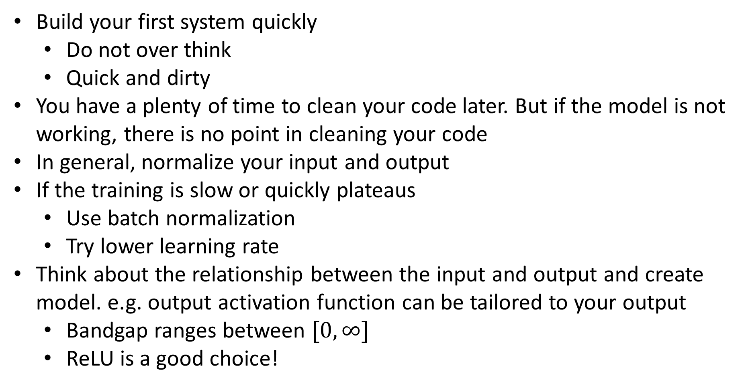

Tips
Build your first system quickly
Do not over think
Quick and dirty
You have a plenty of time to clean your code later. But if the model is not working, there is no point in cleaning your code
In general, normalize your input and output
If the training is slow or quickly plateaus
Use batch normalization
Try lower learning rate
Think about the relationship between the input and output and create model. e.g. output activation function can be tailored to your output
Bandgap ranges between $[0,∞]$
ReLU is a good choice!

Slide 9
Hyperparameter search

Slide 10
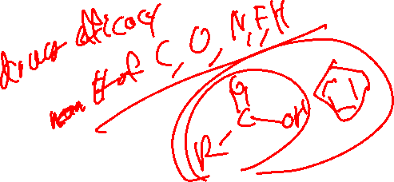
Some intuitions on hyperparameters
α ← very important
β ← 0.9 is a good default
β₁, β₂, ε ← default is usually okay
Model architecture ← You need to develop a task specific model
# layers, # hidden units ← Generally larger the better with regularization
mini-batch size ← minor
…

Slide 11
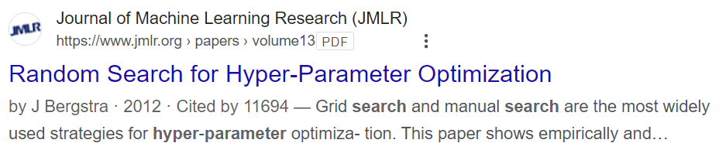
Try random values
Hyperparameters 2
Hyperparameters 2
Hyperparameters 1
Hyperparameters 1
Because of limited time, and we don’t know which hyperparameter is important

Slide 12
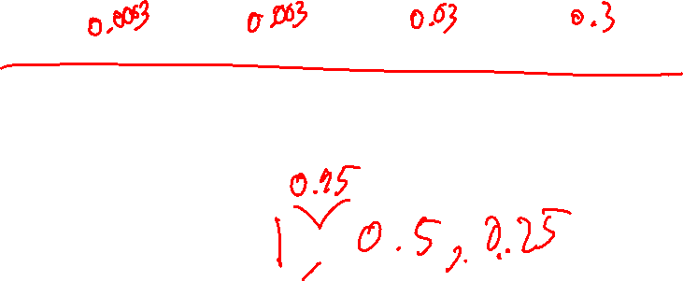
Choosing the right scale
In general, use a logarithmic approach
Number of units
32
64
128
256
α
0.0001
0.001
0.01
0.1
1
alphas = 10**(np.random.uniform(low=-4, high=0, size=(10,)))
# of layers : 2~4
β: 0.9 ~ 0.999
Logarithmic scale helps to search the bigger space quickly.

Slide 13
Current trend in AI development

Slide 14

Two school of engineering
Conventional model-centric approach
AI = Code + Data
Search and applying to new applications
(algorithm/model)
Focus
Algorithm has advanced enough that just building a larger model with larger data is enough
Data-centric approach
AI = Code + Data
Realize application at the large scale
(algorithm/model)
Focus

Slide 15
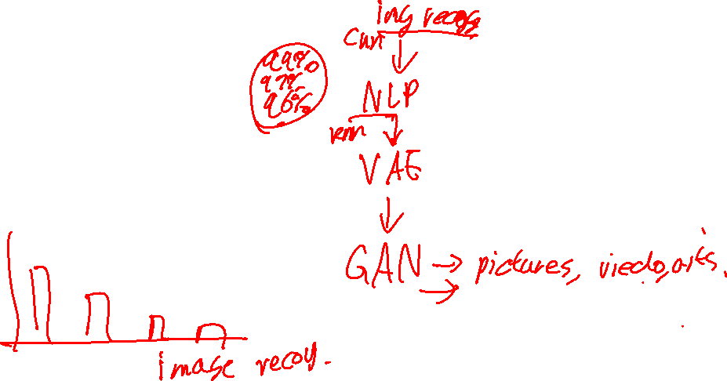
Conventional model-centric approach
Focus on performance improvement
Area focusing on new capability
More about bias, variance controlling, collecting more data and marginal improvement to models
Less about bias, variance controlling.
More about constructing an innovative entirely new framework

Slide 16
Transfer Learning

Slide 17

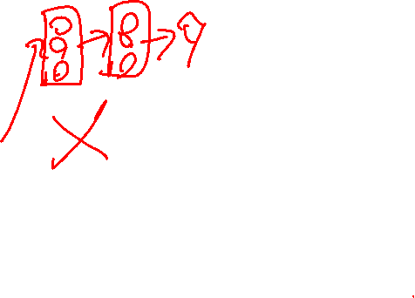



Transfer learning
Utilizing the other model’s learned parameter
A model trained on millions of data
$$X$$
…
…
…
…
…
$$\hat{y}$$
Retrain the (part of) model with your small data set (~1000)
$$X$$
…
…
…
…
…
$$\hat{y}$$
Option 1: only retrain output layer
Option 2: make a new output layer and retrain
Option 3: retrain all parameters
The popular options nowadays

Slide 18
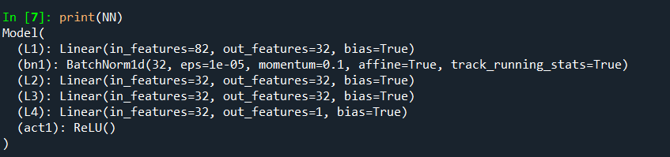
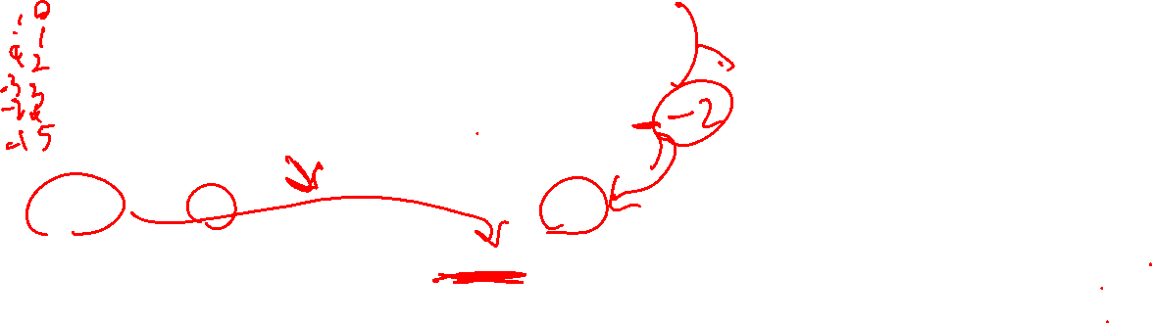
Fixing the parameters
To loading the existing parameters, load the parameters before training
Model.load_state_dict(torch.load('best.pth.tar'))
Train only the part of the parameters:
print(NN)
params =list(NN.parameters())[-2]
optimizer = optim.Adam(params, lr=0.01)

